Slide 1
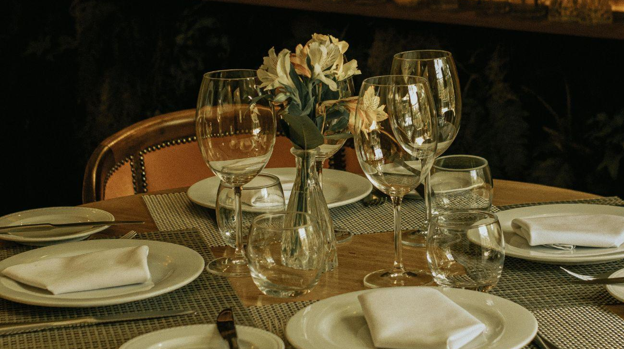
BCI II
Full Flavor, Half the Time:
Scaling Porcini's Pronto for Maximum Returns
How can Porcini drive domestic growth by launching Pronto, focusing on quick & efficient, high quality food to travelers while achieving profitable returns?
Group 5

Slide 2
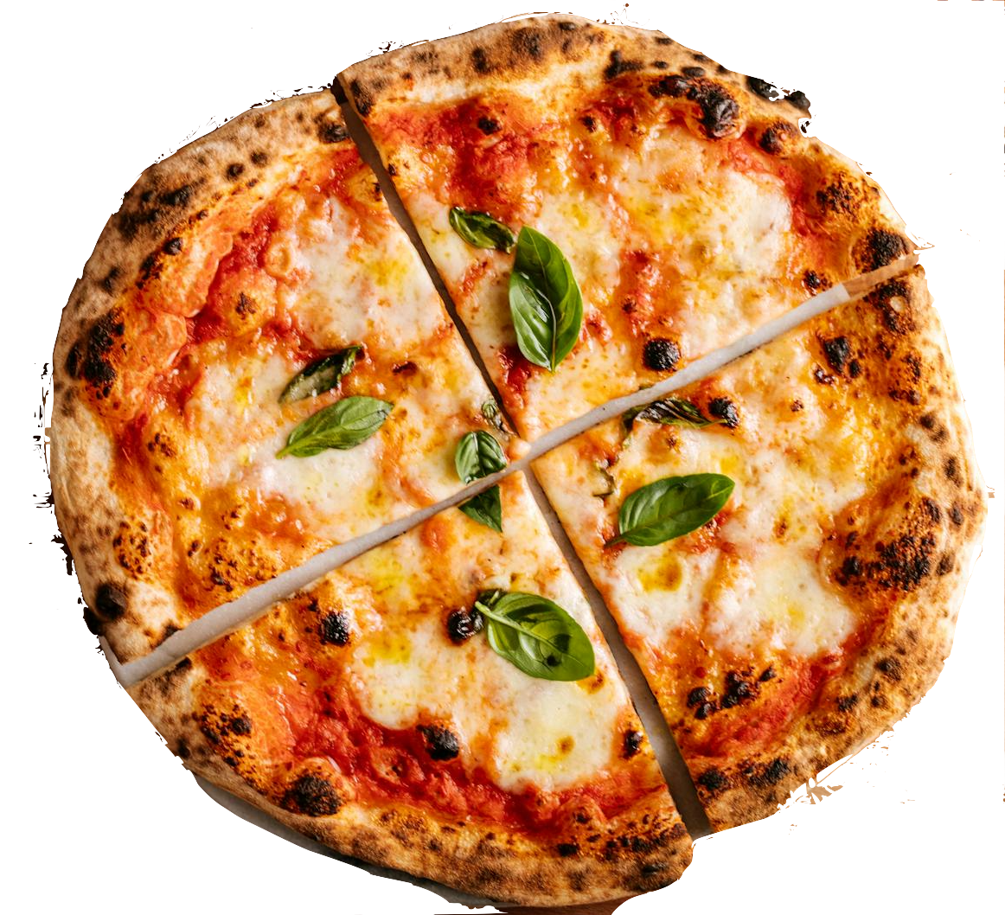
Positive Profits for Pronto under Porcini by 2016…
Executive Summary
Key Issues
Mandate
Alternatives
Impact
”
How can Porcini drive domestic growth by launching Pronto, focusing on quick & efficient, high quality food to travelers while achieving profitable returns?
1.
Organic, Company-Owned Growth
109M+ in Total Revenue by 2016
Maintaining food & service quality
2.
Franchising
1 Million DKK in Profits by 2027
Comparing & Contrasting the best expansion model
88.9K+ in Franchise Royalties by 2016
>
>
>
3.
Standing out with Porcini’s Competitive Edge
Syndication
4.95% Gross Profit Margin by 2016
“

Slide 3
Key Issues

Slide 4
Our top 3 priorities for Porcini are based on…
Key Issues
1
2
3
Keeping Food and Service Quality
Finding the Best Expansion Model
Beating the Competition
Porcini’s is famous for high-quality food and great service.
Porcini’s food is “almost all made from scratch” and the service is “the best.”
A fast service model could damage its reputation.
Owning is expensive
Franchising can lower quality
Investors take part of the money.
Cracker Barrel and Denny’s
Fast food
“Almost any place that serves food is our competitor.”
Notes:
Firstly, the Organic, Company-Owned option involves Porcini’s buying property, building the restaurants, and maintaining complete control over operations and brand quality. Growth, however, would be gradual due to higher capital demands.
Secondly, the Syndication approach has Porcini’s initially constructing the restaurants, then selling the properties to external investors while continuing to operate them. Investors own the real estate and receive property-related returns, while Porcini’s keeps operational profits and retains control of daily management.
Lastly, the Franchising model means franchisees independently fund, own, and operate the restaurants under Porcini’s brand guidelines. Porcini’s supports these franchisees by setting strict operational and quality standards and providing marketing resources, but franchisees handle all initial and ongoing expenses."

Slide 5
Analysis

Slide 6
Porcini’s Financial Performance indicates…
Financial Analysis
Key financial risks
Revenue (2010): $94,3 million
High capital requirements
Profit Margin (2010): 4%
Uncertain revenue performance of Pronto
Number of locations: 23
Potential brand dilution
Average revenue per location: $4,1 million
Competitive market with established players
Porcini’s has maintained revenue growth but profit margin has been average amongst competitors, with low differentiation.
Notes:
Key Competitors for Pizzetta
Direct Competitors:
National Pizza Chains Focused on Quick Service:
Domino’s (25 Locations in Charlotte)
Pizza Hut (18 Locations in Charlotte)
Papa John’s (18 Locations in Charlotte)
Little Caesars (8 Locations in Charlotte)
Regional/Local Pizza Chains:
Blaze Pizza (2 Locations in Charlotte)
Mellow Mushroom (2 Locations in Charlotte)
MOD Pizza (5 Locations in Charlotte)
Local (Independent) Pizzerias:
Aside from the 78 national and regional pizza chains within Charlotte, Pizzetta competes against locally owned independent pizzerias that may be more customer-service and authenticity-focused.
Indirect Competitors:
Sandwich/Sub Shops offer fast and casual dining options that could draw customers away from Pizzetta.
Subway (30 Locations in Charlotte)
Jimmy John’s (17 Locations in Charlotte)
Panera Bread (16 Locations in Charlotte)
Fast & Casual Italian-Style Restaurants
Olive Garden To-Go
Other Quick Eats
Culver’s
Cookout
Bojangles
In-n-Out
Local (Independent) Cafés and Delis
Pizzetta competes against locally owned cafés and delis that provide quick, local eats for the neighbourhood.

Slide 7
We aim to capture the our audience with the large market with…
Market Analysis
Competitive landscape
Customer analysis
4 key customer groups
Direct competitors
Olive Garden
Cracker Barrel
Bob Evans and Denny’s
Indirect competitors
Pizza Hut
McDonalds
Burger King
Starbucks
Business Travelers – Want fast service and a higher-quality meal than fast food.
Vacation Travelers & Families – Prefer affordable, sit-down meals, especially with children-friendly options.
Office Workers (Local Customers) – Looking for quick lunch options in areas near Pronto locations.
Budget-Conscious Travelers – Seek value for money, preferring meals in the $9-$17 range for dinner.
1
2
Key competitive challenges for Pronto
>
Brand recognition disadvantage: Denny’s has 97% of national awareness while Porcini’s is only known regionally
Competing with fast-food restaurants
Prime location availability
Notes:
Shared Core Competencies
Passion for Authentic Italian Cuisine
Martin Blair has a love for authentic Italian food. As a result, he has brought this cuisine back to the U.S. to share it with his local neighbourhood.
Focus on Customer Experience
Martin Blair has ensured that freshness and a positive and authentic environment are at the forefront of his businesses.
Strong Local Presence
The establishments had lines out the door, displaying the neighbourhood’s excitement about the new venues.
High-End Italian: Sophisticated, authentic dining for affluent neighborhoods and special occasions.
Casual Fast-Food Italian: Affordable, customizable meals for younger demographics and families seeking convenience.
ore Competencies of Pizzetta
High-quality, freshly produced and sourced food.
Pizzetta handmakes its food directly in front of the customer, using only the finest locally or artisanally produced ingredients.
Modern/Hip Atmosphere
Martin Blair created a space that displayed an atmosphere that mirrored the quality and uniqueness of his product.
Quick Service & Affordable
Pizzetta focuses on being less expensive and keeps a simple operational strategy to increase efficiency and service times.
Core Competencies of Viva Italia
Authentic Italian Trattoria Experience
Martin Blair set out to create a restaurant replicating the atmosphere and preparation of Italian Trattoria restaurants, bringing the authentic Italian experience to the U.S.
Full-Day Operations
Like many restaurants in Italy, Martin Blair developed a menu that would work for breakfast, coffee, lunch and dinner. This allowed him to serve three meals daily while offering lighter options such as pastries and drinks.
Warm, Neighbourly Atmosphere
Real Italian trattorias are often seen as casual neighbourhood restaurants. Martin Blair has attempted to copy this feeling, bringing the warm environment home.
Operational Expertise
Hired a real chef, giving her 10% equity in the company to inspire her to help grow the business.

Slide 8
Recommendations

Slide 9
Our alternatives for expansion are…
Alternative Analysis
1
2
3
Organic, Company-Owned
Syndication
Franchising
Porcini’s purchases land, constructs, and fully owns each location
Operations and quality fully controlled by Porcini’s management
Expansion limited by internal financing and capital availability
Initially building restaurants, then selling real estate to external investors
Operating restaurants and maintaining control over day-to-day operations
Investors receive returns from property earnings; Porcini’s retains operational profits
Franchisees independently own and operate restaurants under Porcini’s brand
Setting operational guidelines, quality standards, and marketing support
Franchisees responsible for all initial capital investment and ongoing operations
Notes:
Firstly, the Organic, Company-Owned option involves Porcini’s buying property, building the restaurants, and maintaining complete control over operations and brand quality. Growth, however, would be gradual due to higher capital demands.
Secondly, the Syndication approach has Porcini’s initially constructing the restaurants, then selling the properties to external investors while continuing to operate them. Investors own the real estate and receive property-related returns, while Porcini’s keeps operational profits and retains control of daily management.
Lastly, the Franchising model means franchisees independently fund, own, and operate the restaurants under Porcini’s brand guidelines. Porcini’s supports these franchisees by setting strict operational and quality standards and providing marketing resources, but franchisees handle all initial and ongoing expenses."

Slide 10





Selecting the right strategy in achieving our targets to bring long-term success
Alternative Analysis
Alternative Analysis
Worst Alternative
Best Alternative
Criteria
Company-owned
Syndication
Franchising
Operational Control
Speed of Expansion
Capital Intensity
Profit Margin
6% pre-tax
4% pre-tax
2% net
Brand Consistency
Notes:
Based on the decision matrix, I recommend franchising as the best strategic option for Porcini’s Pronto. While it offers lower operational control than company-owned sites, it excels where it matters most for this expansion: speed and scalability. Franchising allows rapid rollout along interstate highways, capturing time-sensitive traffic and building early brand presence.
It also minimizes capital intensity—critical for a company like Porcini’s with limited resources—enabling growth without tying up funds in property and construction. Although the profit margin is lower at 2%, the ability to scale quickly compensates by driving higher aggregate returns. this margin is also after tax, so the other ones may be lower.
Yes, brand consistency poses a risk due to lower operational control—but this can be mitigated through carefully designed contracts, strict quality standards, and close monitoring. In short, franchising balances financial prudence, market opportunity, and strategic growth—making it the best fit for achieving Porcini’s domestic expansion mandate.

Slide 11
Selecting the right strategy in achieving our targets to bring long-term success
Alternative Analysis
Alternative Analysis
Worst Alternative
Best Alternative
Criteria
Company-owned
Syndication
Franchising
Operational Control
Speed of Expansion
Capital Intensity
Profit Margin
6% pre-tax
4% pre-tax
2% net
Brand Consistency
Notes:
Based on the decision matrix, I recommend franchising as the best strategic option for Porcini’s Pronto. While it offers lower operational control than company-owned sites, it excels where it matters most for this expansion: speed and scalability. Franchising allows rapid rollout along interstate highways, capturing time-sensitive traffic and building early brand presence.
It also minimizes capital intensity—critical for a company like Porcini’s with limited resources—enabling growth without tying up funds in property and construction. Although the profit margin is lower at 2%, the ability to scale quickly compensates by driving higher aggregate returns. this margin is also after tax, so the other ones may be lower.
Yes, brand consistency poses a risk due to lower operational control—but this can be mitigated through carefully designed contracts, strict quality standards, and close monitoring. In short, franchising balances financial prudence, market opportunity, and strategic growth—making it the best fit for achieving Porcini’s domestic expansion mandate.

Slide 12
Implementation

Slide 13
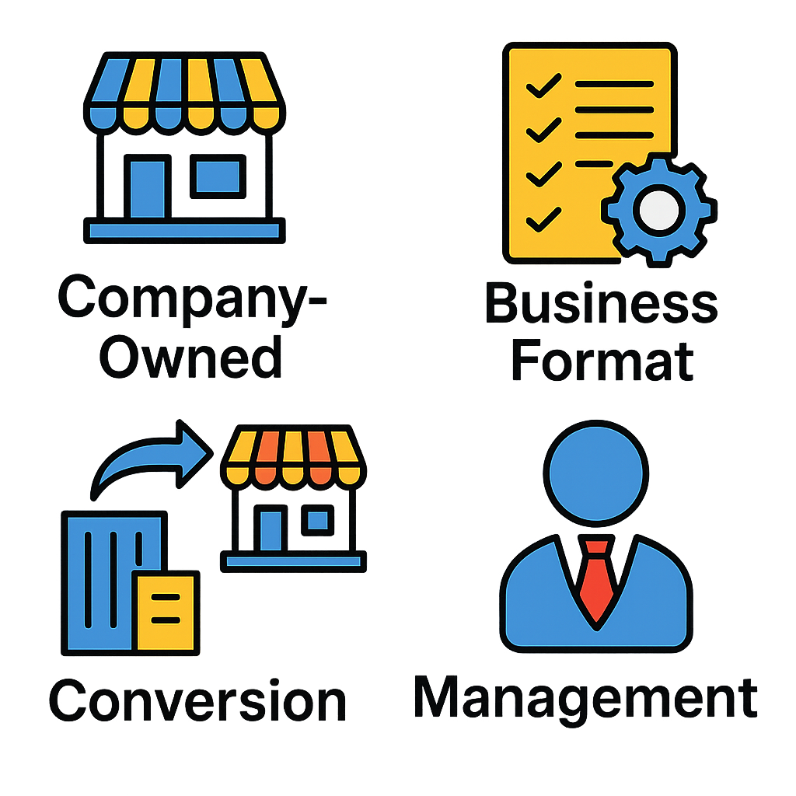




The Hows & Whys on the franchise model as the best fit for our goals
Strategy Implementation
Why a Multi-Unit / Area Developer Model?
Target Franchisee Profile
Why this model beats expectations
Faster Market Penetration
We are looking for partners with.
Partners help secure prime highway spots, beating big players
Location Leverage
Franchisees commit to opening multiple units → rapid growth
1. Experience in F&B operations
2. Access to prime highway/roadside real estate
3. Strong capital base for multi-unit development
4. Understanding of regional market needs
5. Willingness to uphold Porcini’s quality reputation
6. Capacity to co-invest in marketing & hiring
→ These partners are key to scaling regionally and building recognition beyond current regional awareness
Strategic Scale, Without Brand Risk
Franchising avoids brand dilution by choosing quality partners, not volume
Capital Efficiency
Franchisees fund locations → Porcini grows with low investment
Self-sustaining Growth Engine
Profitable operators reinvest, creating a flywheel effect
Maintains Strategic Control
We work closely with our partners
in providing Pronto with minimal risk
& strong revenue growth
Porcini sets standards, owns brand, trains key partners
Notes:
Based on the decision matrix, I recommend franchising as the best strategic option for Porcini’s Pronto. While it offers lower operational control than company-owned sites, it excels where it matters most for this expansion: speed and scalability. Franchising allows rapid rollout along interstate highways, capturing time-sensitive traffic and building early brand presence.
It also minimizes capital intensity—critical for a company like Porcini’s with limited resources—enabling growth without tying up funds in property and construction. Although the profit margin is lower at 2%, the ability to scale quickly compensates by driving higher aggregate returns. this margin is also after tax, so the other ones may be lower.
Yes, brand consistency poses a risk due to lower operational control—but this can be mitigated through carefully designed contracts, strict quality standards, and close monitoring. In short, franchising balances financial prudence, market opportunity, and strategic growth—making it the best fit for achieving Porcini’s domestic expansion mandate.

Slide 14
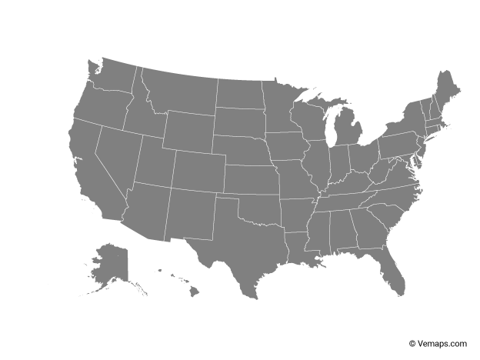
Porcini’s must balance brand familiarity, highway traffic, and strategic expansion potential for an ideal location
Strategy Implementation
Midwest (e.g., Ohio, Illinois)
Central to national highways with cost-efficient real estate
High road trip volume
Good balance of cost and reach Best for scalable rollout after initial success
Southeast (e.g., Georgia, North Carolina) Lower brand awareness, but strong highway use
Potential for family/vacation segment
Mid-term expansion opportunity
Northeast (e.g., Pennsylvania, New York) High brand familiarity and dense population Strong traveler volume Early adopters likely Best region to launch pilot locations
West (e.g., California, Texas) Low brand awareness and expensive real estate High competition Low priority for now
Notes:
Based on the decision matrix, I recommend franchising as the best strategic option for Porcini’s Pronto. While it offers lower operational control than company-owned sites, it excels where it matters most for this expansion: speed and scalability. Franchising allows rapid rollout along interstate highways, capturing time-sensitive traffic and building early brand presence.
It also minimizes capital intensity—critical for a company like Porcini’s with limited resources—enabling growth without tying up funds in property and construction. Although the profit margin is lower at 2%, the ability to scale quickly compensates by driving higher aggregate returns. this margin is also after tax, so the other ones may be lower.
Yes, brand consistency poses a risk due to lower operational control—but this can be mitigated through carefully designed contracts, strict quality standards, and close monitoring. In short, franchising balances financial prudence, market opportunity, and strategic growth—making it the best fit for achieving Porcini’s domestic expansion mandate.

Slide 15
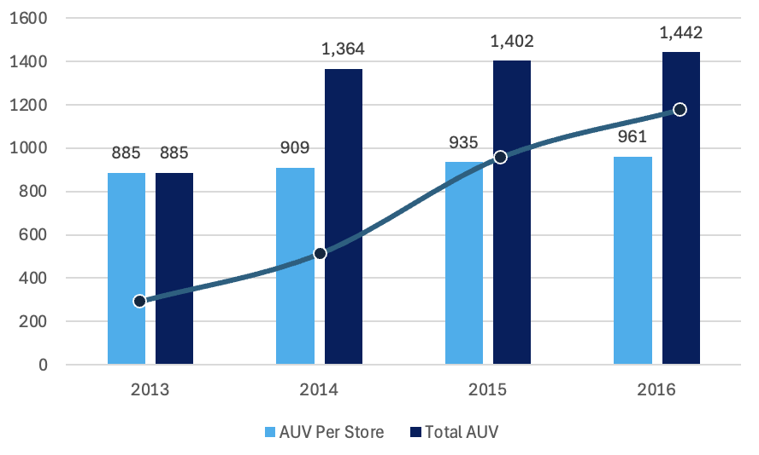
We bring stable & rapid growth through our franchising strategy on a store-wide level
We aim to build 5 franchises in the next 3 years, generating stable, yet high growth revenue by…
Strategy Implementation
884.7K+ Generated with our First Store
35K | Customers Per Annum
25 | Expected Ticket Size
884.7K | Expected AUV
22.5K | Initial Franchise Fee
17.6K | Franchise Operating Fee
40K | Applicant Fee
80K+
Revenue from Initial Franchise Launch
17M+
Lifetime revenue per franchise
5
Franchises to be built in 3 years
Notes:
Based on the decision matrix, I recommend franchising as the best strategic option for Porcini’s Pronto. While it offers lower operational control than company-owned sites, it excels where it matters most for this expansion: speed and scalability. Franchising allows rapid rollout along interstate highways, capturing time-sensitive traffic and building early brand presence.
It also minimizes capital intensity—critical for a company like Porcini’s with limited resources—enabling growth without tying up funds in property and construction. Although the profit margin is lower at 2%, the ability to scale quickly compensates by driving higher aggregate returns. this margin is also after tax, so the other ones may be lower.
Yes, brand consistency poses a risk due to lower operational control—but this can be mitigated through carefully designed contracts, strict quality standards, and close monitoring. In short, franchising balances financial prudence, market opportunity, and strategic growth—making it the best fit for achieving Porcini’s domestic expansion mandate.

Slide 16
Risk, Mitigations, and Implementation Timeline
A Scalable Franchise Rollout Strategy to Be Achieved in 3 years
Steps | Year 0 |  |  | Year 1 |  |  | Year 2 |  |  | Year 3
Franchise Model Finalization
Legal & Brand Guidelines Setup
Sourcing Area Developers
Location Scouting & Contracts
Pilot Store Launches
Multi-unit Rollout
Hiring & Training Toolkit
Operational Reviews
Brand Marketing Ramp-Up
Must Win Battles & KPIs
1
Pilot Franchise Launch
2
Area Developer Agreements Secured
3
Brand Awareness Lift
→ At least 3 locations live by Q3 Year 1
→ 5 multi-unit franchise deals signed by end of Year 2
→ +25% recognition in target regions by Q1 Year 3

Slide 17
Impact

Slide 18
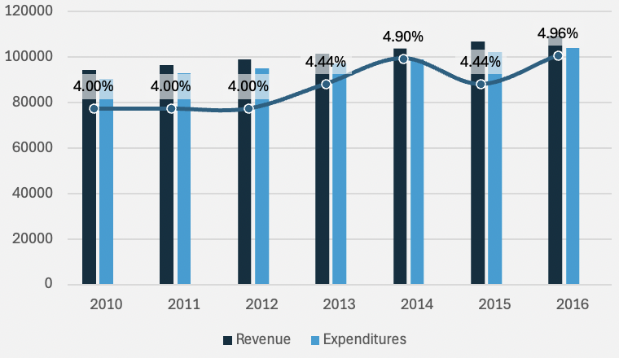
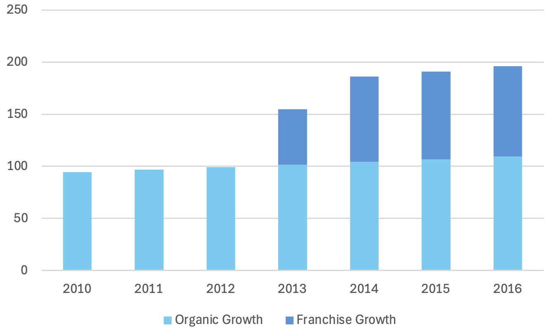
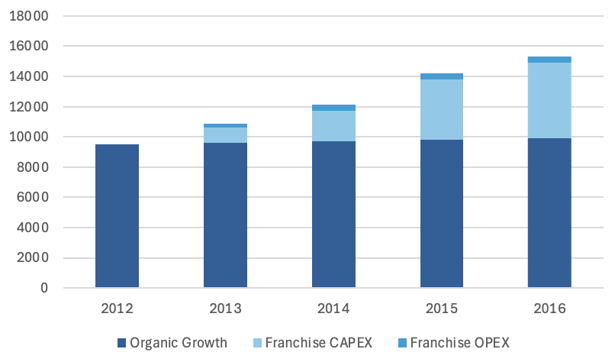
Financial Impact
Balancing Risk & Reward while generating steady returns
Economies of Scale allow for us to reach 4% with a Franchising strategy
Revenue Breakdown
Values in 000 USD
109.4M+ in Total Revenue
Revenue Breakdown
2.85%
Revenue CAGR (2013-2016)
88.9K+
Expected Royalties in Franchises by 2016
4.7%
Expenditures Breakdown
Gross Profit Margin (2013-2016)
3.08%
Capital Expenditure from Total Investment
Assumptions
2.5% Industry Growth Rate for main chain, 2% Growth of Fast Food Sector
Porcini takes 6% Royalties from Franchisor
0.03%
Maintaining a 4-5% GPM & 300K+ in Total Franchising Royalties
Operational Expenditure from Total Investment

Slide 19
Risk, Mitigations, and Implementation Timeline
A Well-balanced Strategy to be Achieved by 2016
Quality Erosion: Franchising/syndication may dilute food/service standards
Deploy Pathfinder Teams to train new units and conduct monthly mystery shopper audits (target ≥85/100).
1
1
2
Low Brand Awareness: Highway travelers may prefer familiar chains like Denny’s
Partner with gas stations (e.g., Shell) for co-branding and offer GPS-targeted discounts via Waze/Google Maps.
Severity of risk
2
3
3
Labor Shortages: High turnover may worsen in rural highway locations
Implement attendance bonuses (1 extra PTO day/month) and cross-train staff for flexible coverage.
1
2
3
Probability of occurrence

Slide 20
Full Flavor, Half the Time: Scaling Porcini's Pronto for Maximum Returns
Executive Summary
Key Issues
Mandate
Alternatives
Impact
”
How can Porcini drive domestic growth by launching Pronto, focusing on quick & efficient, high quality food to travelers while achieving profitable returns?
1.
Organic, Company-Owned Growth
109M+ in Total Revenue by 2016
Maintaining food & service quality
2.
Franchising
1 Million DKK in Profits by 2027
Comparing & Contrasting the best expansion model
88.9K+ in Franchise Royalties by 2016
>
>
>
3.
Standing out with Porcini’s Competitive Edge
Syndication
4.95% Gross Profit Margin by 2016
“

Slide 21
Executive Summary
Company Overview
Market Landscape & Competitor Analysis
Customer Analysis
Location Analysis
Alternatives
Alternative 1
Alternative 2
Alternative 3
Recommendations
Impact
Implementation
Risks
Appendix

Slide 22
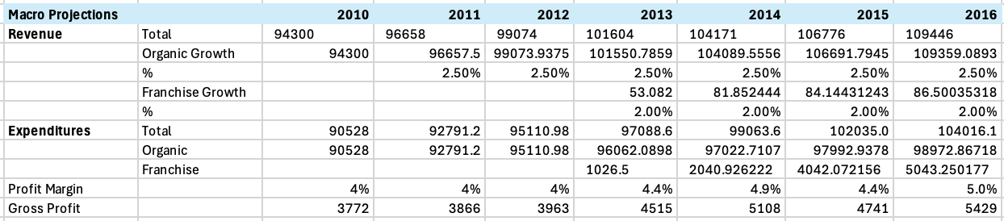
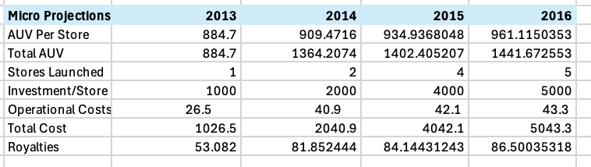
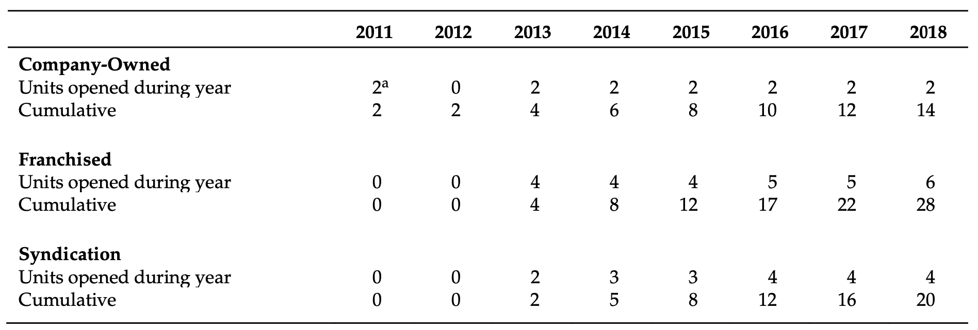
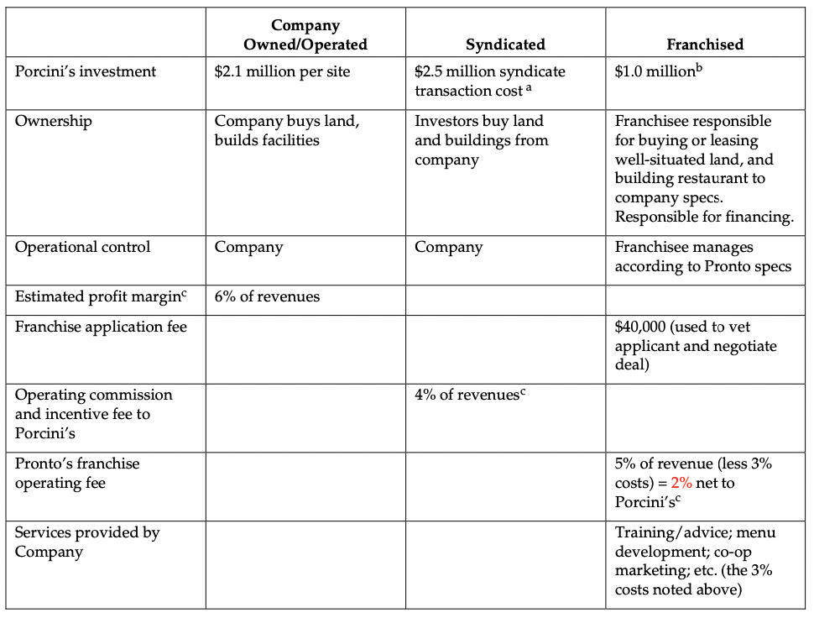
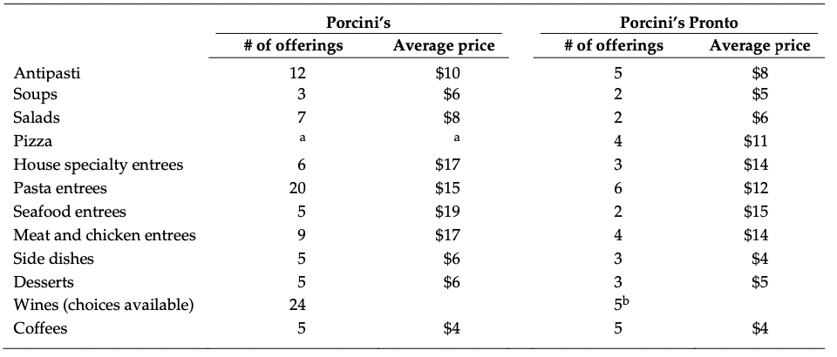
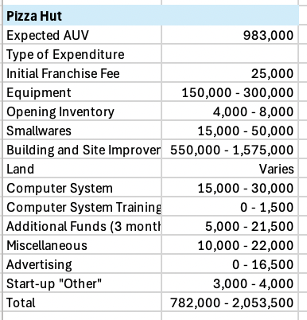
Financial Overview
Financial estimates for strategy

Slide 23
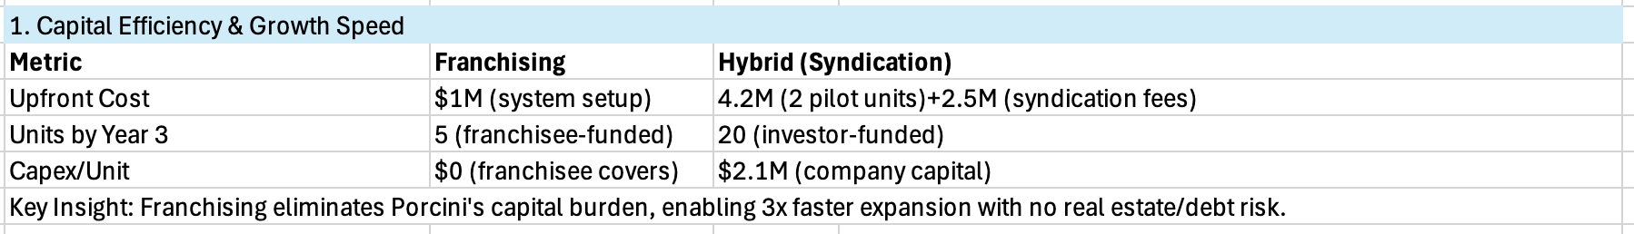
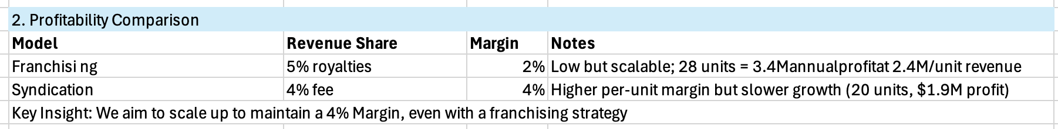
Franchising vs Hybrid: Porcini’s core competencies in quality assurance allow for it to be scaled up with ambitious plans for revenue growth
Charlotte, North Carolina, is a rapidly growing city with a diverse population and a mix of cultural and economic influences. Understanding the demographics and preferences of Charlotte residents can help determine whether they are more likely to be interested in high-end Italian food or casual fast-food Italian. Here's an analysis:
Demographics of Charlotte, NC
Population Growth:
Charlotte is one of the fastest-growing cities in the U.S., with a population of over 900,000 (city proper) and 2.7 million in the metropolitan area.
The city attracts young professionals, families, and retirees due to its strong economy and quality of life.
Age Distribution:
Median Age: 34.6 years (younger than the national median of 38.5).
A significant portion of the population is in the 25-44 age range, which is a key demographic for dining out.
Income Levels:
Median Household Income: ~
65,000(slightlyabovethenationalmedianof
65,000(slightlyabovethenationalmedianof 62,000).
The city has a growing affluent population, particularly in neighborhoods like SouthPark, Ballantyne, and Dilworth, where incomes are higher.
Cultural Diversity:
Charlotte is becoming increasingly diverse, with a growing Hispanic/Latino population (14%) and a significant African American population (35%).
The city also has a growing international community, including professionals and students.
Lifestyle Trends:
Charlotte residents value a mix of convenience and quality. The city has a thriving food scene, with a strong preference for locally owned restaurants and unique dining experiences.
The presence of major corporations (e.g., Bank of America, Wells Fargo, Duke Energy) has created a demand for both upscale dining and quick, casual options.
Interest in High-End Italian vs. Casual Fast-Food Italian
Based on Charlotte's demographics and trends, here's how the interest in high-end Italian and casual fast-food Italian might break down:
High-End Italian Food
Target Audience: Affluent professionals, older millennials, Gen Xers, and retirees in upscale neighborhoods like SouthPark, Myers Park, and Uptown.
Why It Fits:
Charlotte's growing affluent population and strong corporate presence create demand for fine dining experiences.
High-end Italian restaurants can cater to business dinners, date nights, and special occasions.
The city's food scene is becoming more sophisticated, with residents willing to pay for quality and ambiance.
Casual Fast-Food Italian
Target Audience: Younger millennials, Gen Z, families, and budget-conscious diners in suburban areas like University City, Steele Creek, and Concord.
Why It Fits:
The fast-paced lifestyle of young professionals and families makes casual dining a convenient option.
Casual fast-food Italian (e.g., build-your-own pasta bowls, pizza by the slice) appeals to a broader audience, including students and middle-income families.
The city's diverse population may prefer affordable, customizable options.
Market Opportunities
High-End Italian:
Focus on affluent neighborhoods and areas with high foot traffic (e.g., Uptown, South End).
Emphasize premium ingredients, authentic recipes, and a sophisticated dining experience.
Offer wine pairings, private dining, and chef’s table experiences to attract corporate clients and special occasions.
Casual Fast-Food Italian:
Target suburban areas, college campuses, and shopping centers.
Emphasize speed, affordability, and customization (e.g., build-your-own pasta, pizza, or salads).
Leverage delivery and takeout options to cater to busy professionals and families.
Appendix
https://www.deliverect.com/en/blog/trending/exploring-fast-fine-dining-the-rise-of-a-new-food-service-trend

Slide 24
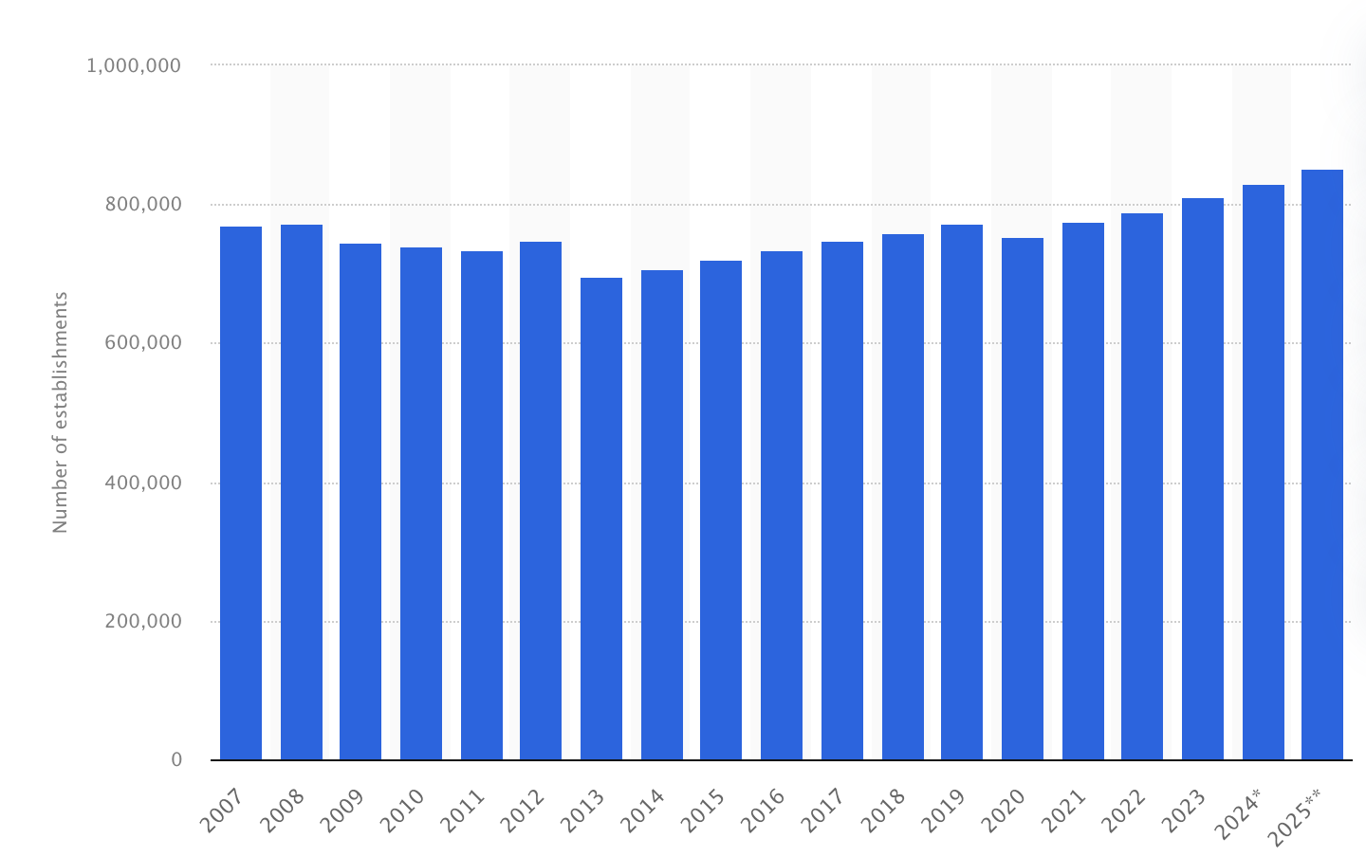
Market Trends in Franchising
Charlotte, North Carolina, is a rapidly growing city with a diverse population and a mix of cultural and economic influences. Understanding the demographics and preferences of Charlotte residents can help determine whether they are more likely to be interested in high-end Italian food or casual fast-food Italian. Here's an analysis:
Demographics of Charlotte, NC
Population Growth:
Charlotte is one of the fastest-growing cities in the U.S., with a population of over 900,000 (city proper) and 2.7 million in the metropolitan area.
The city attracts young professionals, families, and retirees due to its strong economy and quality of life.
Age Distribution:
Median Age: 34.6 years (younger than the national median of 38.5).
A significant portion of the population is in the 25-44 age range, which is a key demographic for dining out.
Income Levels:
Median Household Income: ~
65,000(slightlyabovethenationalmedianof
65,000(slightlyabovethenationalmedianof 62,000).
The city has a growing affluent population, particularly in neighborhoods like SouthPark, Ballantyne, and Dilworth, where incomes are higher.
Cultural Diversity:
Charlotte is becoming increasingly diverse, with a growing Hispanic/Latino population (14%) and a significant African American population (35%).
The city also has a growing international community, including professionals and students.
Lifestyle Trends:
Charlotte residents value a mix of convenience and quality. The city has a thriving food scene, with a strong preference for locally owned restaurants and unique dining experiences.
The presence of major corporations (e.g., Bank of America, Wells Fargo, Duke Energy) has created a demand for both upscale dining and quick, casual options.
Interest in High-End Italian vs. Casual Fast-Food Italian
Based on Charlotte's demographics and trends, here's how the interest in high-end Italian and casual fast-food Italian might break down:
High-End Italian Food
Target Audience: Affluent professionals, older millennials, Gen Xers, and retirees in upscale neighborhoods like SouthPark, Myers Park, and Uptown.
Why It Fits:
Charlotte's growing affluent population and strong corporate presence create demand for fine dining experiences.
High-end Italian restaurants can cater to business dinners, date nights, and special occasions.
The city's food scene is becoming more sophisticated, with residents willing to pay for quality and ambiance.
Casual Fast-Food Italian
Target Audience: Younger millennials, Gen Z, families, and budget-conscious diners in suburban areas like University City, Steele Creek, and Concord.
Why It Fits:
The fast-paced lifestyle of young professionals and families makes casual dining a convenient option.
Casual fast-food Italian (e.g., build-your-own pasta bowls, pizza by the slice) appeals to a broader audience, including students and middle-income families.
The city's diverse population may prefer affordable, customizable options.
Market Opportunities
High-End Italian:
Focus on affluent neighborhoods and areas with high foot traffic (e.g., Uptown, South End).
Emphasize premium ingredients, authentic recipes, and a sophisticated dining experience.
Offer wine pairings, private dining, and chef’s table experiences to attract corporate clients and special occasions.
Casual Fast-Food Italian:
Target suburban areas, college campuses, and shopping centers.
Emphasize speed, affordability, and customization (e.g., build-your-own pasta, pizza, or salads).
Leverage delivery and takeout options to cater to busy professionals and families.
Appendix
In 2024, there were an estimated 811,000 franchise establishments in the United States. Franchising is a business concept where a franchisee is contractually permitted to use the franchisor’s ideas and business model.
Franchising in the United States
The franchise industry in the United States allows for companies to put licenses on their brand and distribute to a separate business. These smaller businesses work under the title of the bigger company. Franchises are available through different types of establishments. More notably, the franchise industry is commonly known for its fast food sector. In 2024, the economic output of franchise establishments in the United States was about 897 billion U.S. dollars. Contributing to the economic output of franchise establishments in the United States were more than 8 million people who worked for a franchise business.
https://www.deliverect.com/en/blog/trending/exploring-fast-fine-dining-the-rise-of-a-new-food-service-trend

Slide 25
Company Analysis
1
STRENGTHS
2
WEAKNESSES
>
Strong brand and quality reputation
Limited capital for expansion
Customer loyalty and unique ambience
Lack of brand recognition outside NorthEast
Consistent financial growth
Operational complexity
Notes:
Shared Core Competencies
Passion for Authentic Italian Cuisine
Martin Blair has a love for authentic Italian food. As a result, he has brought this cuisine back to the U.S. to share it with his local neighbourhood.
Focus on Customer Experience
Martin Blair has ensured that freshness and a positive and authentic environment are at the forefront of his businesses.
Strong Local Presence
The establishments had lines out the door, displaying the neighbourhood’s excitement about the new venues.
High-End Italian: Sophisticated, authentic dining for affluent neighborhoods and special occasions.
Casual Fast-Food Italian: Affordable, customizable meals for younger demographics and families seeking convenience.
ore Competencies of Pizzetta
High-quality, freshly produced and sourced food.
Pizzetta handmakes its food directly in front of the customer, using only the finest locally or artisanally produced ingredients.
Modern/Hip Atmosphere
Martin Blair created a space that displayed an atmosphere that mirrored the quality and uniqueness of his product.
Quick Service & Affordable
Pizzetta focuses on being less expensive and keeps a simple operational strategy to increase efficiency and service times.
Core Competencies of Viva Italia
Authentic Italian Trattoria Experience
Martin Blair set out to create a restaurant replicating the atmosphere and preparation of Italian Trattoria restaurants, bringing the authentic Italian experience to the U.S.
Full-Day Operations
Like many restaurants in Italy, Martin Blair developed a menu that would work for breakfast, coffee, lunch and dinner. This allowed him to serve three meals daily while offering lighter options such as pastries and drinks.
Warm, Neighbourly Atmosphere
Real Italian trattorias are often seen as casual neighbourhood restaurants. Martin Blair has attempted to copy this feeling, bringing the warm environment home.
Operational Expertise
Hired a real chef, giving her 10% equity in the company to inspire her to help grow the business.

